Slide 1
Religious Emblems Program
Black Gold District – GSLAC
“It’s as easy as 1-2-3.”
Goal is 20 Scouts Honored On Scout Sunday 2021!
Presented By
Troop 282 – Flora, IL Chaplain & Wood Badge Candidate
David M. Mills
dm.doc.mills@gmail.com / 618-599-4683

Slide 2
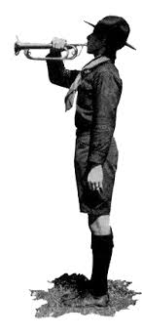
Step One: TELL
Summer - Fall Recruitment
Promote the P.R.A.Y. Awards for General Christian Denominations
Scouts/Parents Partner With Their Minister
E-Mailed Resources Will Include:
Overview & Contact List
P.R.A.Y. Promotional Flyers
Sample Letter To Scouts/Parents
Sample Agreement Letter

Slide 3
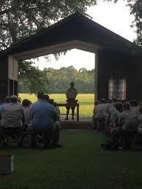
Step Two: SHOW
Fall Program – Christmas
Order Curriculum, Register Scouts, & Check-In On Progress
Scouts/Parents Work Independently With Minister
E-Mailed Resources Will Include:
Class Roster To Track Progress
Prepared/Packaged P.R.A.Y. Curriculum For Each Religious Emblem Program Cub Scouts to Scouts BSA
Monthly Checklist To Stay Organized

Slide 4
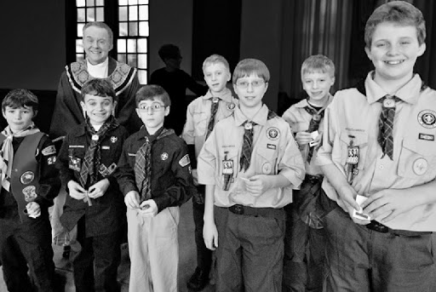
Step Three: DO
New Year – Scout Sunday
Scouts/Parents/Minister Complete Application
Order Medals / Square Knots For Presentation on Scout Sunday
E-Mailed Resources Will Include:
P.R.A.Y. Price List
P.R.A.Y. Store On-Line
Sample Award Script

Slide 5
Moving Forward
Most Scouts in Black Gold District will be Christian through the P.R.A.Y. Awards or Catholic through the Diocese of Belleville Catholic Committee on Scouting. I will share Catholic Committee on Scouting dates when we finalize them.
The Boy Scouts of America has a religious emblems program for all faiths (Jewish, Buddhism, Islam, etc.), so access to curriculum and awards are readily accessible. Just ask and I will help link you with resources.
The religious emblems programs are a great tool for units. They increase the reverence of Scouts and build roads with our charters, churches, and communities. Moreover, they can be completed, with Scouting Spirit, independently at home with parents and at church with a minister.
Lets rise to the challenge and give our Scouts a great COVID-19 quarantine opportunity by helping 20 Black Gold District Scouts earn a religious emblems this year! I look forward to the smiling faces of Scouts being presented medals in February.

