Slide 1
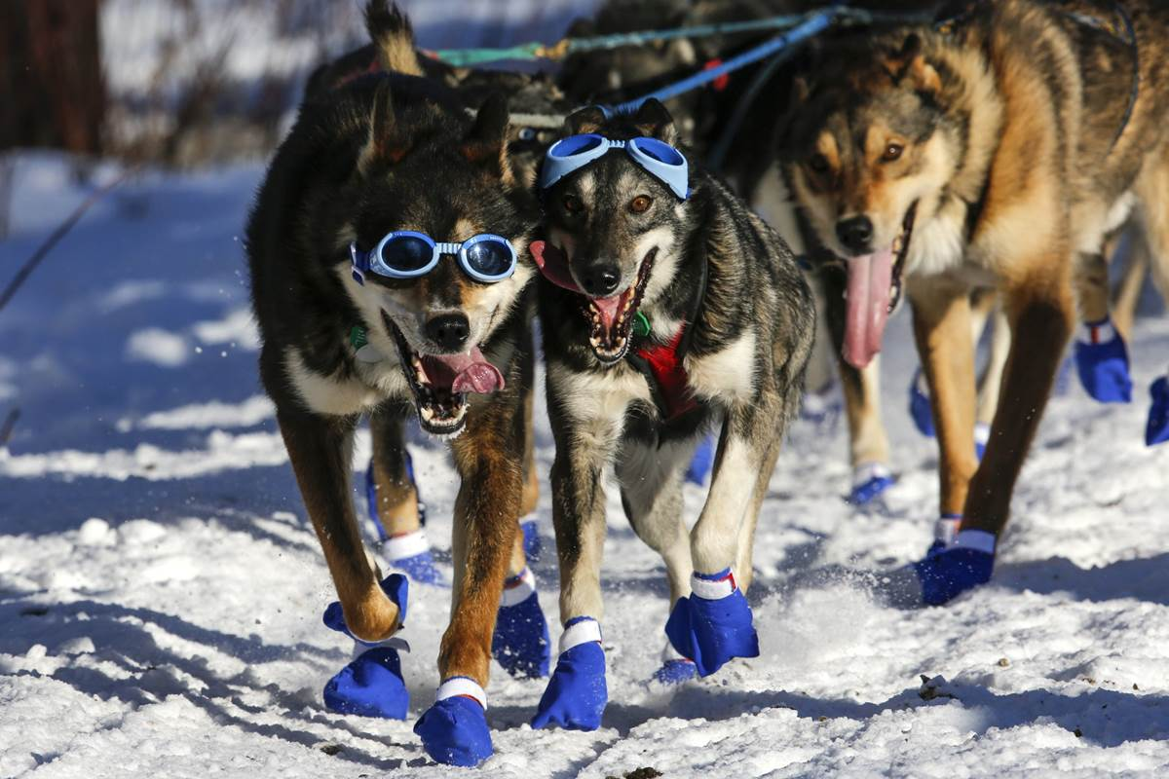
WINTER CAMPING CAN BE FUN...
...When You’re Prepared

Slide 2
TEST YOUR COLD WEATHER KNOWLEDGE
The majority of hypothermic deaths occur between 35°F and ___°F.
Water conducts heat ___ times faster than air.
The three most common cold weather injuries include: ______________, _______________ and _____________________.
T or F Hypothermia starts to be a threat when body temperature drops by 4 degrees.
BSA classifies camping as “Winter Camping” when the temperature drops to ___°F or below.
55
25
DEHYDRATION
HYPOTHERMIA
FROSTNIP/FROSTBITE
TRUE
50

Slide 3
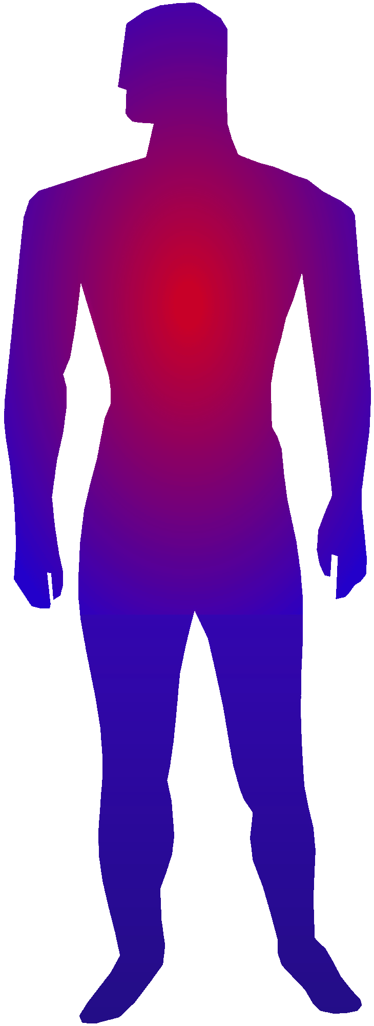
HOW THE BODY REGULATES TEMPERATURE
Works to maintain CORE temperature of 98.6°F to protect vital organs.
Brain is a vital organ but not as critical.
Loosens blood vessels to move heat to the extremities (our “Radiators”).
Constricts blood vessels (blood flow) to warm the CORE as temperature drops.
Help your body regulate temperature...
Keep your core warm (dress correctly),
Avoid tight, constrictive clothing, and
Keep your activity rate up.

Slide 4
MANAGING HEAT LOSS
RADIATION
Up to 55% of heat loss, mainly via the head.
An unprotected head can lose up to ½ the body’s total heat production at 40°F (and up to ¾ at 5°F).
Wear a hat - wool or synthetic.
CONDUCTION
About 7% of heat loss - contact with cold surfaces.
Cover extremities and avoid constrictive clothing.
Use insulated pads to sit or lie on, and STAY DRY (water is a major conductor).

Slide 5
MANAGING HEAT LOSS
CONVECTION
Up to 8% of heat loss - more when very windy.
The body continuously warms a thin layer of air next to the skin... Dressing in layers is critical.
EVAPORATION
About 21% of heat loss - can’t do much about it.
Sweat from the skin and water from the skin and lungs account for a substantial loss of body heat.
Wear clothing that BREATHES... trapped vapor will condense and freeze.

Slide 6
MANAGING HEAT LOSS
RESPIRATION
2 to 9% of heat loss.
Inhaling cool air and exhaling warm air accounts for a significant amount of heat loss.
There is little you can do to prevent this.
MAKE UP FOR HEAT LOSS BY:
The most basic way is to EAT, the body needs fuel to generate heat.
Don’t forget to DRINK, your body needs water to digest food.

Slide 7
“DRESS IN LAYERS”
(What does that really mean?)
WICKING: the “base layer” next to skin
Synthetic long underwear - wicking & breathable.
“Cotton Kills” - its fibers absorb water which freezes, conducting heat away from the body.
Ideally, have a different, clean set for sleeping.
WARMTH: “sub-layering” to regulate heat
Upper: Synthetics, Versatile (shirts, vests, coats...)
Lower: fleece pants work well; wool or wool blend socks and insulated boots.
Balaclava, fleece scarf; wool mittens, synthetic hat.

Slide 8
“DRESS IN LAYERS”
(What does that really mean?)
WIND & WATER: public enemies #1 & #2
Higher quality rain gear works well - it cuts the wind and protects from water/moisture.
SUMMARY:
Wicking (base) Layer - provides warmth and protects from internal moisture by wicking it away.
Warmth Layer - where un-layering (to prevent overheating) and re-layering (to prevent heat loss) occurs - should be multiple, versatile layers.
Wind/Water - protects from wind and external moisture.

Slide 9
DRESSING IN LAYERS
THE OBJECTIVE IS NOT TO BE WARM, BUT
“COMFORTABLY COOL”
Don’t wait until you are cold to put on more clothing.
And don’t wait until you are hot to remove some layers - if you do, you’ll sweat (and sweat is moisture). No es bueno!
Self awareness is the key.

Slide 10
KEEP “COLD” TO STAY WARM
keep Clean
avoid Overheating
wear Layers
stay Dry
Remember this acronym; it will help you develop and learn techniques for staying warm while camping in cold weather.

Slide 11
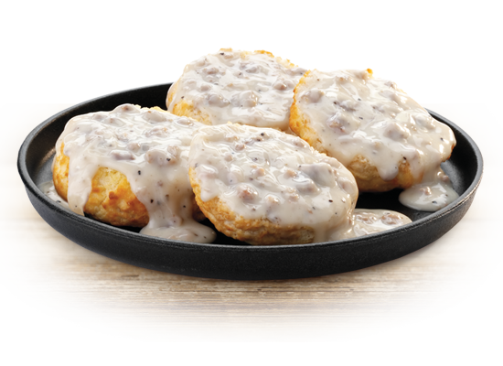
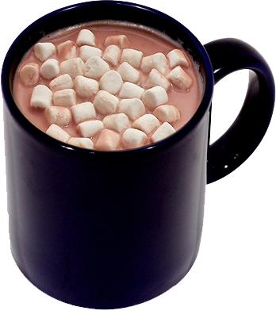
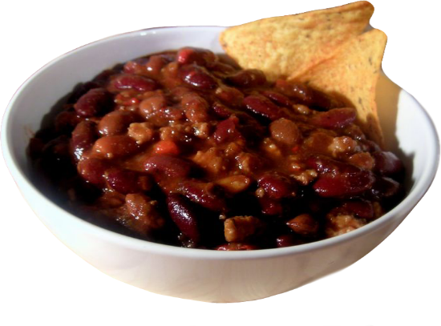
KEEP YOUR ENGINE GOING: FOOD AND WATER
Hot Meals are critical to high morale AND to keeping your body’s heat producing engine running.
Breakfast & Dinner need to be hot. Lunch should have a hot component (e.g.-soup). HOT DRINKS should be available at all meals.
EVERYONE also needs to stay well hydrated.

Slide 12
KEEP YOUR ENGINE GOING:
FUEL TYPES
Except for medically prescribed diets, winter camping is ONE TIME when “bad” food is good!
CARBOHYDRATES (simple sugars, complex carbs) should make up 40-50% of the diet; they burn quickly.
FATS should make up 30-40% of the diet, they burn very slowly.
PROTEINS make up 20% of the diet and burn slow.
Crackerbarrel is CRITICAL: it fuels the body’s furnace for the long night ahead.

Slide 13
COLD WEATHER COOKING TIPS
Open fire is a great way to cook in winter (a tripod works well to suspend pots or grills over the fire).
Pressurized fuel stove works well too, but fuel containers and lines can be “fussy” when too cold:
Store fuel bottles in a cooler with hand warmers.
Make insulated covers for fuel bottles.
Place fuel bottle in a pot of water to insulate it.
Wear gloves when working with liquid fuel - it can cause instant frostbite on exposed skin.
Dutch Ovens require 4-5 times (or more) the normal charcoal (convective/conductive heat loss).

Slide 14
MORE COLD WEATHER TIPS
Winter Camping should NOT be a test of Survival... the odds of losing are high for the inexperienced.
Bring plenty of potable water with you and store it in the warming station if necessary.
Carry FILLED water bottles, hand sanitizer and TP inside one of your warmth layers.
Use the Philmont “human sump” to “clean” dishes after meals (or use paper dishes - they start fires).
Use oven bags in pots to keep them clean(er).
If concerned about food prep sanitation, use boiling water (rolling boil for 1 minute +).

Slide 15
SLEEPING SYSTEMS
If you have a 4-Season tent, use it.
For 3-Season tents:
A tarp floor liner is recommended.
Cover with moving blankets to build insulation.
An emergency blanket on top of that can provide some reflective heat (a mummy-type blanket can be an outer wrapper for a sleeping bag).
Cots are not recommended - open space between cot and floor is a “cold air collector.”
A camp chair helps keep you off the cold floor when changing clothes.

Slide 16
SLEEPING SYSTEMS
Use the lowest temperature-rated sleeping bag you have (or have access to).
Rating denotes survivability - NOT comfort.
Use sleeping bag liners to improve ratings (or a home-made fleece insert).
Dry off (high absorbency towel works great) and change into CLEAN, DRY wicking/base layer.
A warmth layer (or 2) is also a good idea - don’t forget your head, feet and hands!
Keep items you want to keep warm with you.
“Scoutmaster’s Friend...”

Slide 17
OTHER CONSIDERATIONS
A wisk broom is good for removing snow and ice from clothing before entering your tent.
A small snow shovel is great to have when that surprise overnight snowfall hits with 2-3 inches.
In there’s snow on the ground, a sled can be used to move gear to your campsite.
If you find you’re not as well prepared as you thought... there’s no shame in packing it in and going to the Warming Center.
Part of the fun/adventure is in recognizing gear issues, then fixing them by your next outing.

Slide 18
MEDICAL ISSUES:
OVERVIEW
The BUDDY SYSTEM is the FIRST LINE OF DEFENSE when it comes to recognizing “Cold Injuries.”
The 3 most common Cold Injuries are:
Dehydration - which can lead to...
Hypothermia; and,
Frostnip & Frostbite.
These MUST be taken seriously - Hypothermia and Frostbite can change your life... forever.
The intent is NOT to scare anyone, but to underscore how important AWARENESS and the Buddy System are to a fun and safe adventure.

Slide 19
MEDICAL ISSUES:
DEHYDRATION
Two causes:
Loss of body fluids from Perspiration/Respiration brought on by overheating and over-exertion.
Low intake of fluids - more water is needed as activity increases; in extreme temperatures.
The body needs water to function efficiently.
Slows body process of creating energy from food;
Hinders logical thought processes; and,
Dulls dexterity.
So, don’t over-exert & overheat, and be sure you’re drinking enough water.

Slide 20
MEDICAL ISSUES:
DEHYDRATION
Self-Awareness:
Headache, irritability, dark urine, fatigue.
Awareness in Others - the “UMBLES:”
Stumbles & Fumbles (loss of dexterity and muscle control);
Mumbles & Grumbles (irritability, altered personality)
Prevention is the BEST treatment - hydrate!!
Treatment after the fact includes sipping water slowly but constantly; and, resting and staying warm.

Slide 21
MEDICAL ISSUES:
HYPOTHERMIA
Hypothermia is the lowering of body heat.
Mild Hypothermia is a drop to 97 - 95°F
Medium Hypothermia is a drop to 94 - 90°F
Below 90°F is SEVERE as the body is no longer able to regenerate any of its own heat.
One of the first things to be affected is your ability to assess yourself rationally.
Know yourself and your limits... be able to recognize when you’re getting too cold.
BE AWARE AND USE THE “BUDDY SYSTEM!”
Watch for the “UMBLES” - they are early signs.

Slide 22
MEDICAL ISSUES:
3 STAGES OF HYPOTHERMIA
SYMPTOM | STAGE 1 | STAGE 2 | STAGE 3
Body Temperature | Drop of 2-3°F | Drop of 4-8°F | Below 90°F
Shivering | mild to strong | becomes violent | usually stops
Dexterity | hands become numb | movement slow & labored, uncoordinated | difficulty speaking, thinking, using hands, and walking
Respiration | quick and shallow | breathing continues to be difficult | pulse and respiration decreases

Slide 23
MEDICAL ISSUES:
HYPOTHERMIA
Response and treatment must be immediate once symptoms occur:
The victim MUST be warmed up;
Change out of damp clothes;
Put on more layers (sleeping bag); and,
Prevent further cold exposure.
Build a fire, but avoid re-warming with “Dry Heat.”
Give warm fluids and high energy foods.
If the condition is too severe or continues (Stage 2 and Stage 3) EVACUATE the victim - professional medical care is prudent and may be necessary.

Slide 24
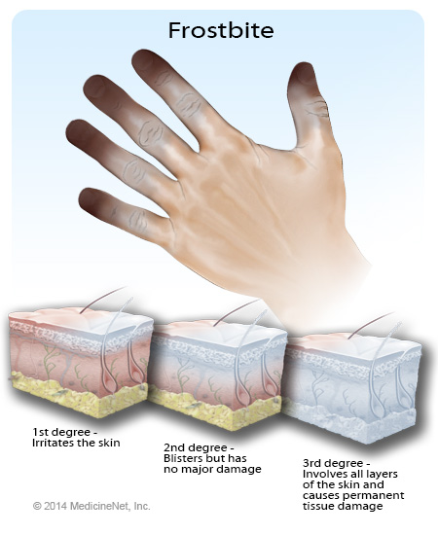
MEDICAL ISSUES:
FROSTNIP / FROSTBITE
Frostnip
(1st Degree)
Temporary Damage
Superficial Frostbite
(2nd Degree)
Permanent Damage Possible
Deep Frostbite
(3rd / 4th Degree)
Permanent Damage

Slide 25
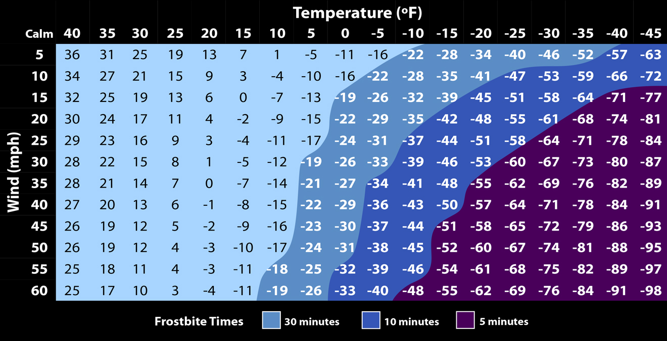
FROSTNIP / FROSTBITE
Water conducts heat 25 times faster than air

Slide 26
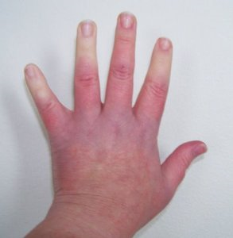
FROSTNIP
1st Degree

Slide 27
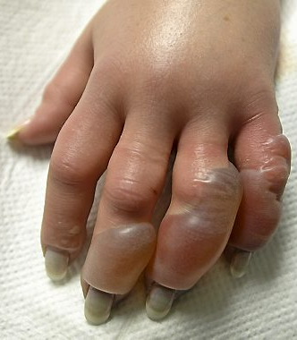
SUPERFICIAL FROSTBITE
2nd Degree

Slide 28
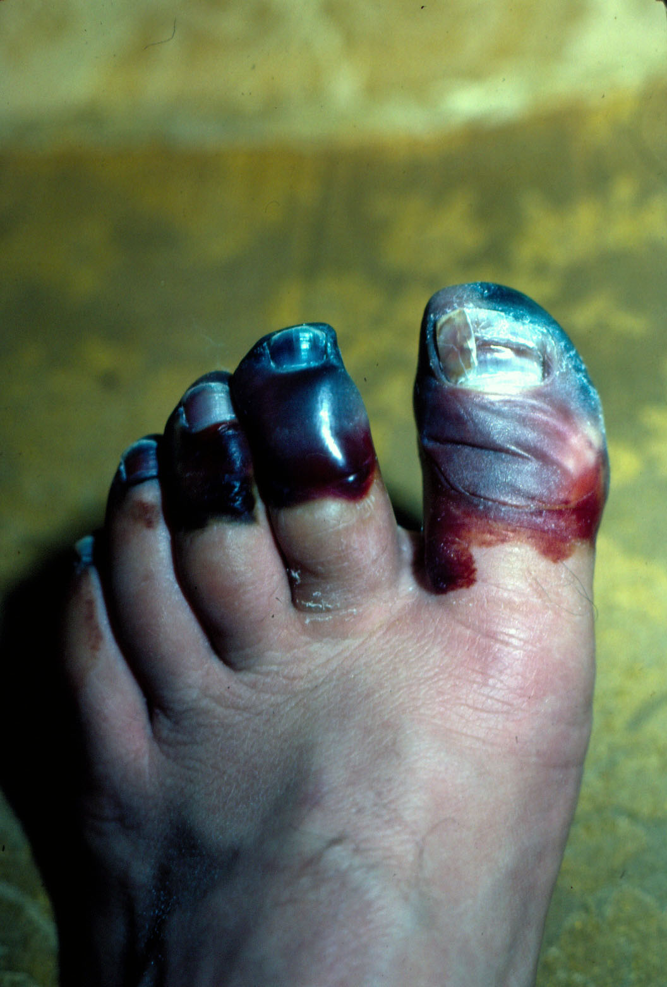
DEEP FROSTBITE
3rd Degree

Slide 29
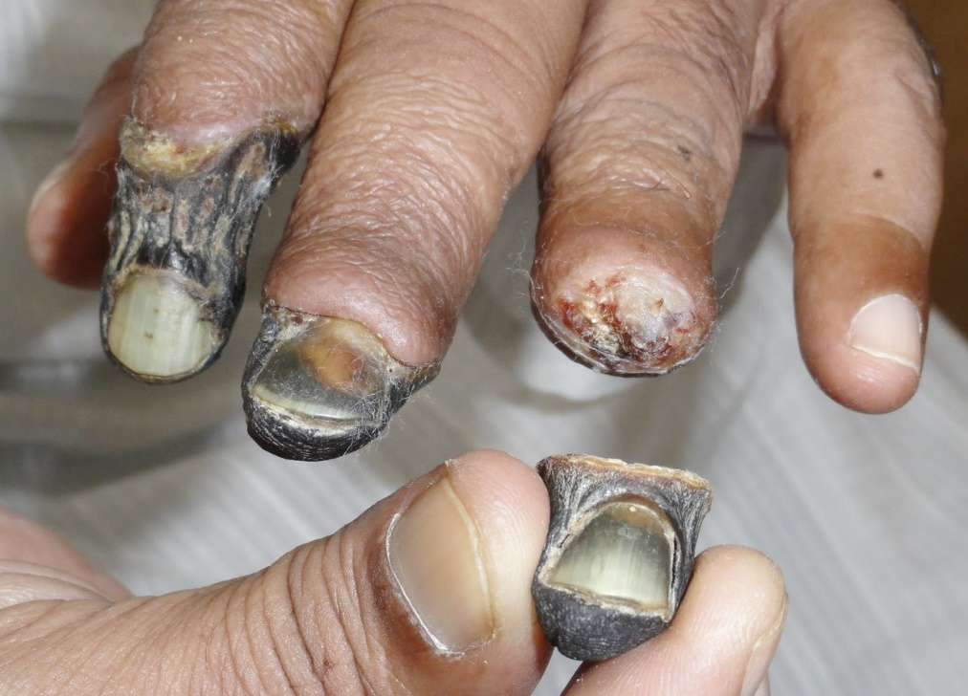
DEEP FROSTBITE
4th Degree

Slide 30
MEDICAL ISSUES:
FROSTNIP / FROSTBITE
Prevention includes:
Being aware, especially of your extremities.
Guard against wind and wear proper clothes. Wicking, Warmth and Wind/Water-proof layers keep you dry and conserve body heat.
Don’t wear tight clothes - they increase conductive heat loss and reduce circulation.
Drink! Drink! Drink! A hydrated body metabolizes food into energy.
Buddy System... watch each other !

Slide 31
MEDICAL ISSUES:
FROSTNIP / FROSTBITE
Treatment includes:
Body cells are frozen - they’re fragile like a plastic bag full of sharp icicles.
Rubbing to warm causes these sharp icicles to damage the surrounding cells... Do Not Rub
It is NOT recommended to re-warm the injury in the field, keep it bundled.
Don’t let the injury refreeze!
EVACUATE FROM THE FIELD

Slide 32
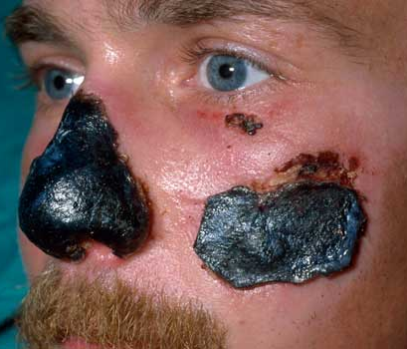
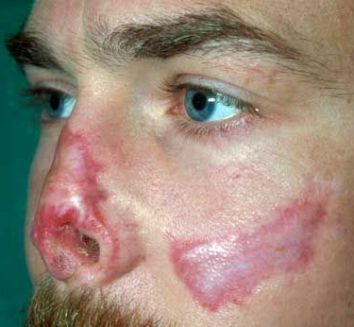
BE PREPARED and BE AWARE
People have died of Hypothermia with extra warm clothes in their packs they forgot about

Slide 33
MEDICAL ISSUES:
SUNBURN & SNOW BLINDNESS
Both caused by exposure to ultraviolet radiation:
Sunny or cloudy days (snow and ice reflect up to 75% of the sun’s rays)
SUNBURN affects earlobes, underside of chin and nose, and the lips.
Use sunscreen & lip balm with SPF (30+).
SNOW BLINDNESS is sunburn of the retina and symptoms are dryness and irritation up to 6-8 hours after exposure.
Prevent by wearing dark, UV PROTECTANT sunglasses and a hat with a brim

Slide 34
MEDICAL ISSUES:
BURNS
May occur from boiling water, stove fuel, campfire or camp stove.
Use caution when filling water bottles with boiling water.
Always wear rubber gloves when handling stove fuel.
Treatment is the same as in the summer... Cool. Clean. Cover.

Slide 35
For more information, check out BSA’s Okpik Cold Weather Camping at the Scout Shop
For a winter camping packing list
Goggle “boys life article 6981”

Slide 36
WHAT ARE YOUR QUESTIONS?

Slide 37
If you have any questions that come up, and/or if you’d like me to email you the PDF of the Cold Weather Injuries Notes I consolidated for OKPIK, email me at...
cjkeesey@gmail.com
christopher.keesey@shawneelodge.org
As a favor in return, PLEASE include the name of, and contact info for, your OA Troop Rep; and, let me know if your troop is going out of council for summer camp in 2017. Thank you.

Slide 38
SEE YA’ FRIDAY-SUNDAY,
JANUARY 20-22 AT BEAUMONT!

Slide 39
RISK MANAGEMENT CYCLE
What are the risks?
What are the causes?
Identify
RISK

Slide 40
RISK MANAGEMENT CYCLE
Assess Prioritize
Plan
Real or perceived?
How probable?
Catastrophic or minor?
How to minimize
How to avoid
Identify
RISK

Slide 41
RISK MANAGEMENT CYCLE
Assess Prioritize
Plan
Finalize and communicate plans
Train your people
Enact plans as needed
Avoid risk when possible
Identify
RISK
Treat Avoid

Slide 42
RISK MANAGEMENT CYCLE
Assess Prioritize
Plan
What really worked?
What didn’t work at all?
What could have worked better?
Helps further minimize or avoid risk
Identify
RISK
Treat Avoid
Monitor Improve

